Slide 1
BERT Visualization
Xueren Ge
Haibei Zhu

Slide 2
Goal
Tackle “Anisotropy” problem within BERT
How to visualize anisotropy problem
How to solve anisotropy problem
Understand why BERT work
Does BERT really learn contextual information?
The importance of each layer in BERT
How to build better BERT
Structure
Dataset

Slide 3
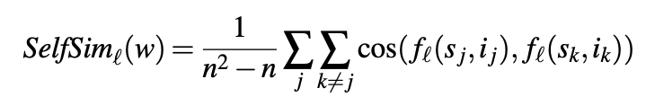
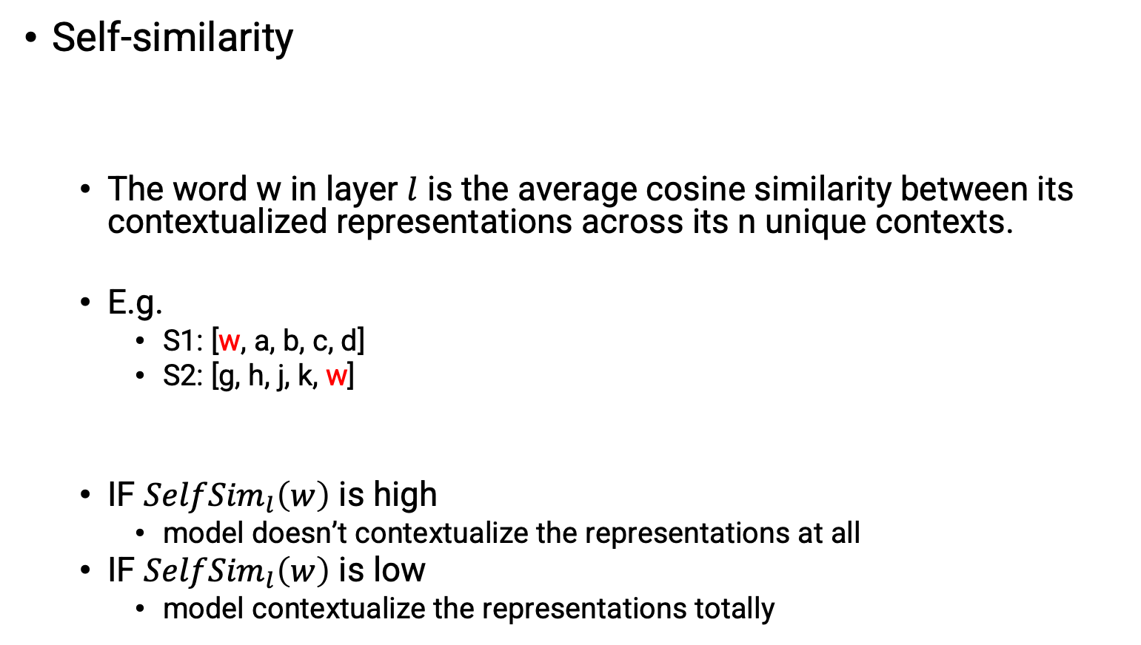
Metrics
Self-similarity
The word w in layer $l$ is the average cosine similarity between its contextualized representations across its n unique contexts.
E.g.
S1: [w, a, b, c, d]
S2: [g, h, j, k, w]
IF ${SelfSim}_{l}\left(w\right)$ is high
model doesn’t contextualize the representations at all
IF ${SelfSim}_{l}\left(w\right)$ is low
model contextualize the representations totally
How Contextual are Contextualized Word Representations? Comparing the Geometry of BERT, ELMo, and GPT-2 Embeddings
https://aclanthology.org/D19-1006.pdf

Slide 4
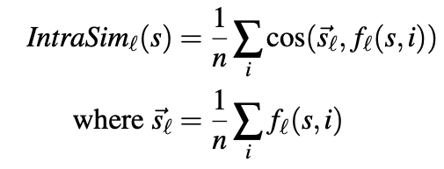
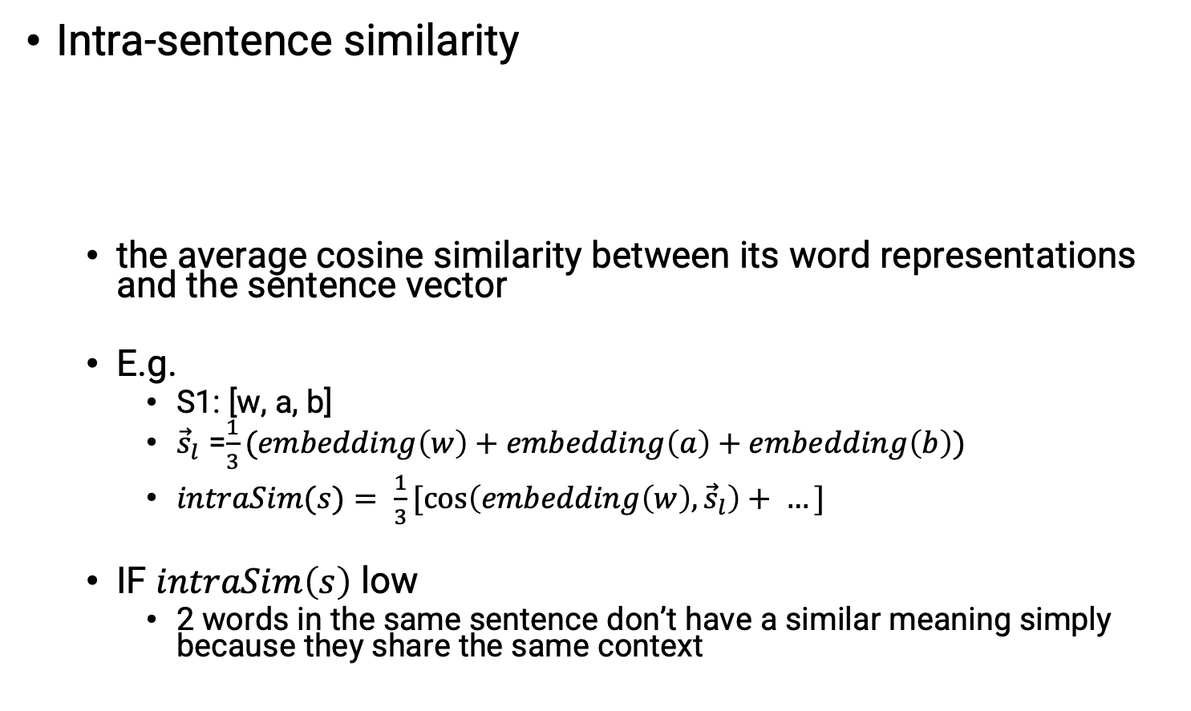
Metrics
Intra-sentence similarity
the average cosine similarity between its word representations and the sentence vector
E.g.
S1: [w, a, b]
${\vec{s}}_{l}$ =$\frac{1}{3}(embedding\left(w\right)+embedding\left(a\right)+embedding\left(b\right))$
$intraSim(s)= \frac{1}{3}[cos\left(embedding\left(w\right),{\vec{s}}_{l}\right)+ …]$
IF $intraSim\left(s\right)$ low
2 words in the same sentence don’t have a similar meaning simply because they share the same context
How Contextual are Contextualized Word Representations? Comparing the Geometry of BERT, ELMo, and GPT-2 Embeddings
https://aclanthology.org/D19-1006.pdf

Slide 5
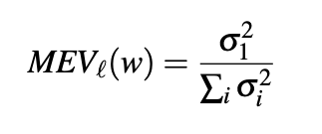
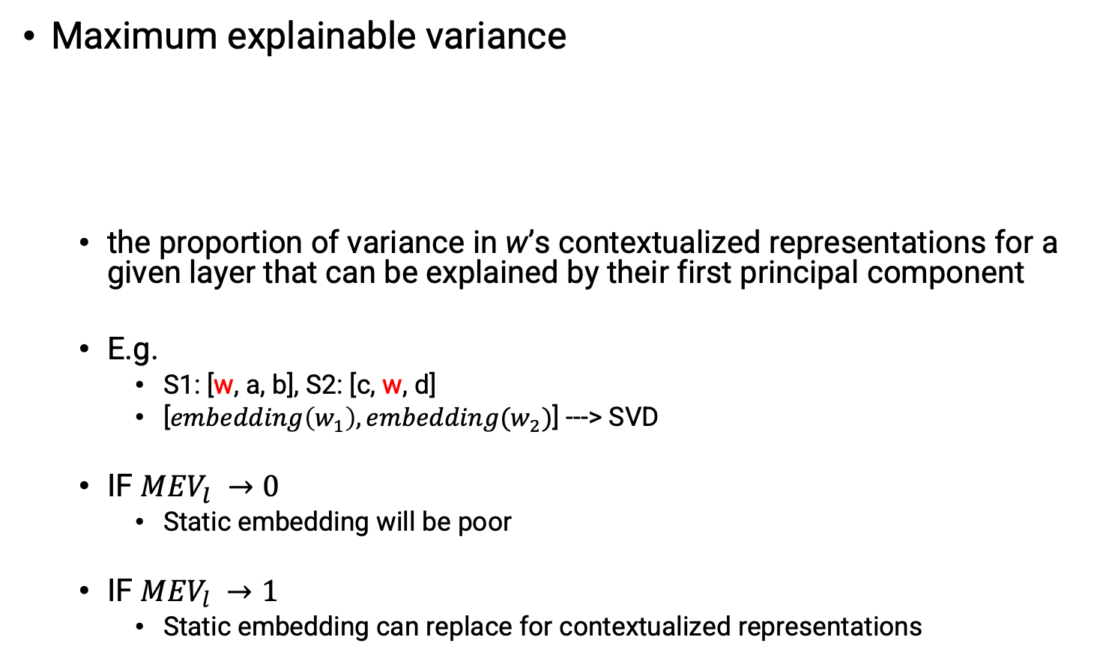
Metrics
Maximum explainable variance
the proportion of variance in w’s contextualized representations for a given layer that can be explained by their first principal component
E.g.
S1: [w, a, b], S2: [c, w, d]
[$embedding\left(w_{1}\right), embedding(w_{2})$] ---> SVD
IF ${MEV}_{l} →0$
Static embedding will be poor
IF ${MEV}_{l} →1$
Static embedding can replace for contextualized representations
How Contextual are Contextualized Word Representations? Comparing the Geometry of BERT, ELMo, and GPT-2 Embeddings
https://aclanthology.org/D19-1006.pdf

Slide 6
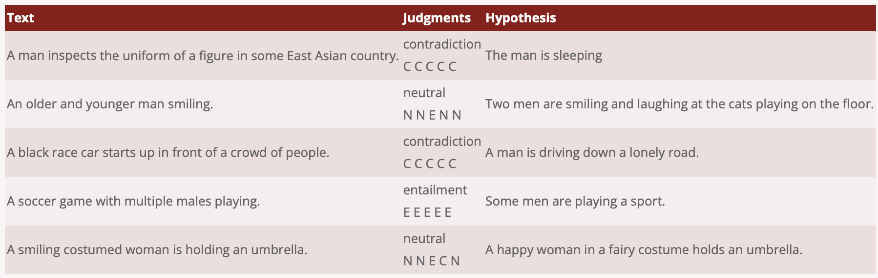
Data
Stanford Natural Language Inference (SNLI) Corpus
https://nlp.stanford.edu/projects/snli/
How Contextual are Contextualized Word Representations? Comparing the Geometry of BERT, ELMo, and GPT-2 Embeddings
https://aclanthology.org/D19-1006.pdf

Slide 7
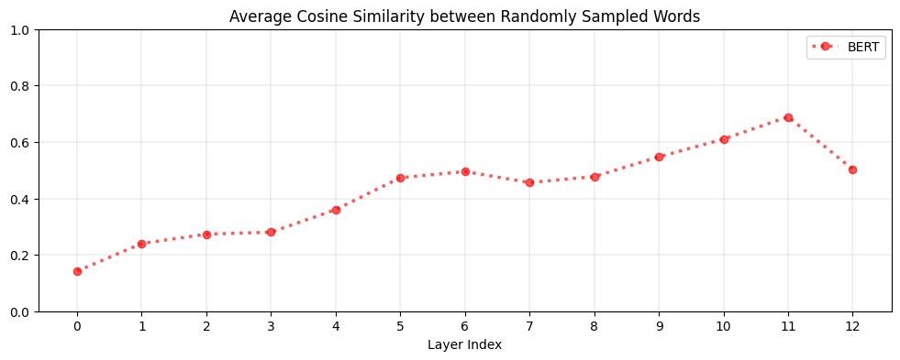
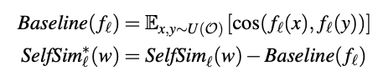
Anisotropy
We randomly select 2 words and calculate the cosine similarity, and find that as layer goes deeper, any words cosine similarity grows →
Any 2 random words have similar representation, which means, the whole vector space tend to be a cone instead of ball.
How to adjust for it?
Use anisotropy baseline
How Contextual are Contextualized Word Representations? Comparing the Geometry of BERT, ELMo, and GPT-2 Embeddings
https://aclanthology.org/D19-1006.pdf

Slide 8
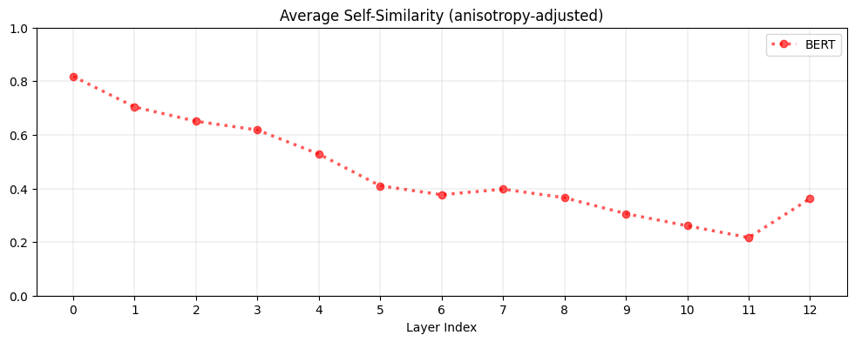
Results
Self-Similarity
The higher the layer, the lower the self-similarity, suggesting that contextualized word representations are more context-specific in higher layers.
How Contextual are Contextualized Word Representations? Comparing the Geometry of BERT, ELMo, and GPT-2 Embeddings
https://aclanthology.org/D19-1006.pdf

Slide 9
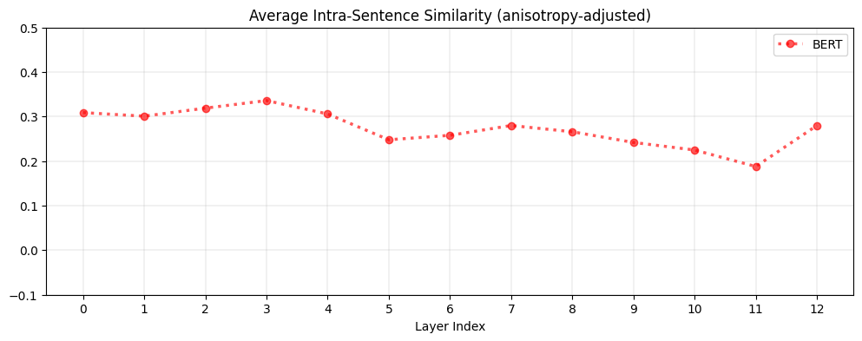
Results
IntraSimilarity
As layer goes deeper, 2 words in the same sentence have lower Intra-sentence similarity → 2 words don’t have the same meaning even when they share the same context.
How Contextual are Contextualized Word Representations? Comparing the Geometry of BERT, ELMo, and GPT-2 Embeddings
https://aclanthology.org/D19-1006.pdf

Slide 10
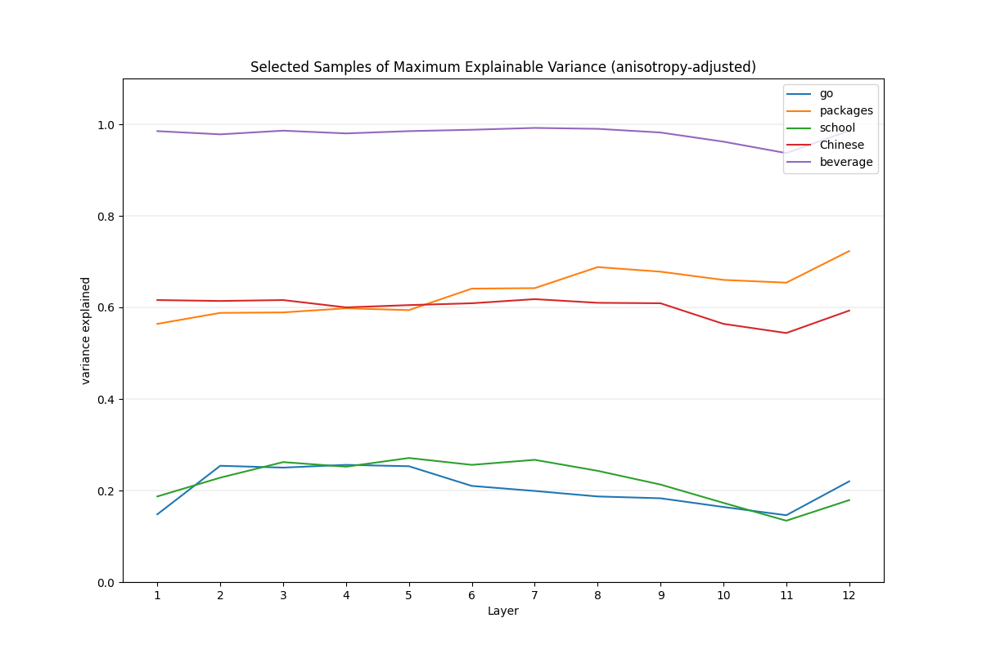
Results
Maximum explainable variance
We randomly select samples and plot its MEV, for example, ’beverage’ is almost 1, which means in all context , in all layers its meaning is almost the same. And can be replaced by static embedding.
While ’go’, ‘school’ may have low multiple meaning in different context.
How Contextual are Contextualized Word Representations? Comparing the Geometry of BERT, ELMo, and GPT-2 Embeddings
https://aclanthology.org/D19-1006.pdf

Slide 11
Results
IntraSimilarity
Interesting Findings:
In layer 12, both SelfSim and intraSim increases, which means
Word gets less contexualized, the same word tend to have similar contexlization embedding. (bad)
Two words in the same sentence have a similar meaning because they share the same context. (bad)
How Contextual are Contextualized Word Representations? Comparing the Geometry of BERT, ELMo, and GPT-2 Embeddings
https://aclanthology.org/D19-1006.pdf

Slide 12
Future Work
Data-biased
Inspired by Last class ethics, we planned to change the data distribution, let it be biased-dataset, and see what Bert will learns and what’s going on in each layer
Structure
We have seen layer 12 may have bad performances, we planned to use Hugging Face to froze some layers to see what Bert will react.
Anisotropy
Maybe use contrastive learning to see how to solve this problem

